Slide 1
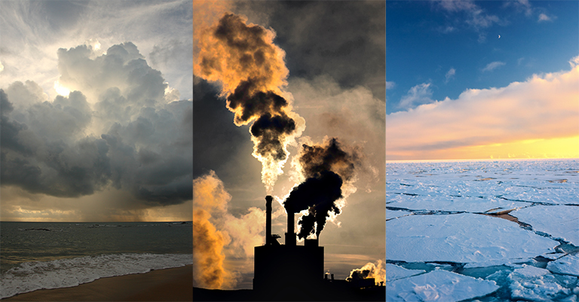
What You've (Probably) Wondered About Climate Change
Ryan Tamashiro
Lai Jiang
Alan Tsai
Jerica Saengaram

Slide 2
Agenda
Topic Overview - Ryan
Regional Climate Trends - Lai
Regional Pollution Trends - Alan
Global Natural Disasters - Jerica
Final Takeaways - Ryan

Slide 3
Research Questions
Questions
How has temperature changed over time?
Has precipitation been affected by climate change?
To what extent has pollution and air quality changed over time?
Are natural disasters more common today as a result of climate change?
There’s plenty of evidence to show that climate change is real, but we as a population might not know to what extent it has been changing and what impact humans have had upon it.
Overview
Climate Trends
Pollution Trends
Natural Disasters
Final Takeaways

Slide 4
Data Sources
Regional Climate Data (NOAA)
State of Global Air
Hurricane Data (NOAA)
Earthquake Data (USGS)
Overview
Climate Trends
Pollution Trends
Natural Disasters
Final Takeaways

Slide 5
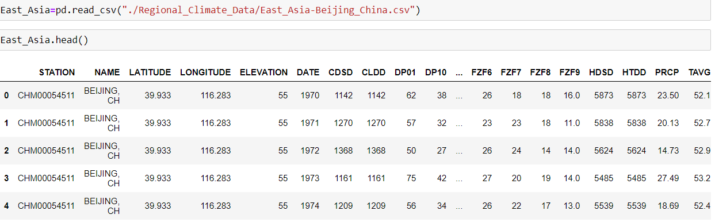
Climate：Loading Data
Overview
Climate Trends
Pollution Trends
Natural Disasters
Final Takeaways

Slide 6
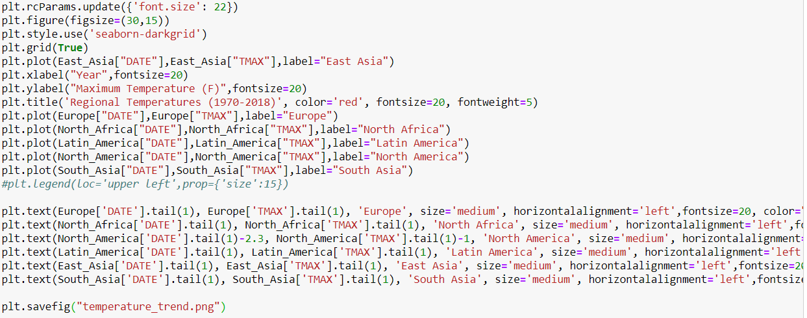
Climate：Graphing Temperature Trend
Overview
Climate Trends
Pollution Trends
Natural Disasters
Final Takeaways

Slide 7
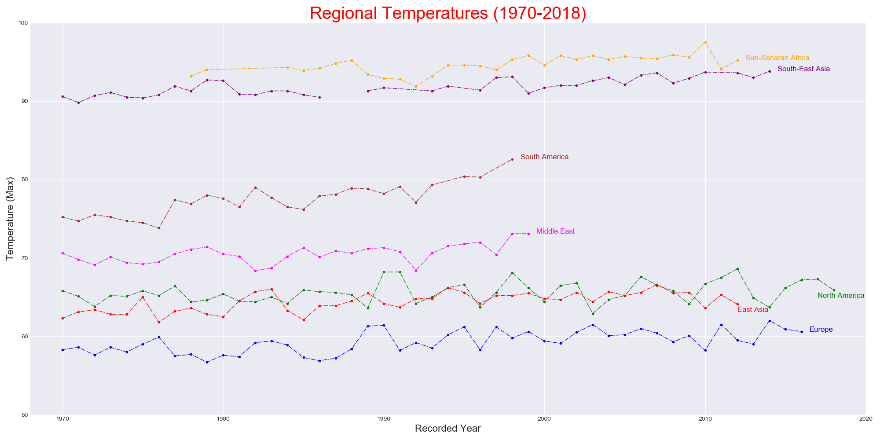
Temperature Trend
Overview
Climate Trends
Pollution Trends
Natural Disasters
Final Takeaways

Slide 8
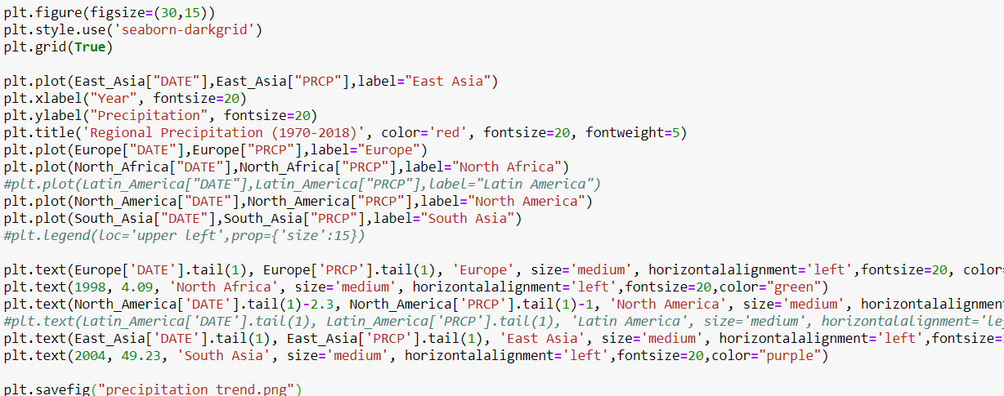
Climate：Graphing Precipitation Trend
Overview
Climate Trends
Pollution Trends
Natural Disasters
Final Takeaways

Slide 9
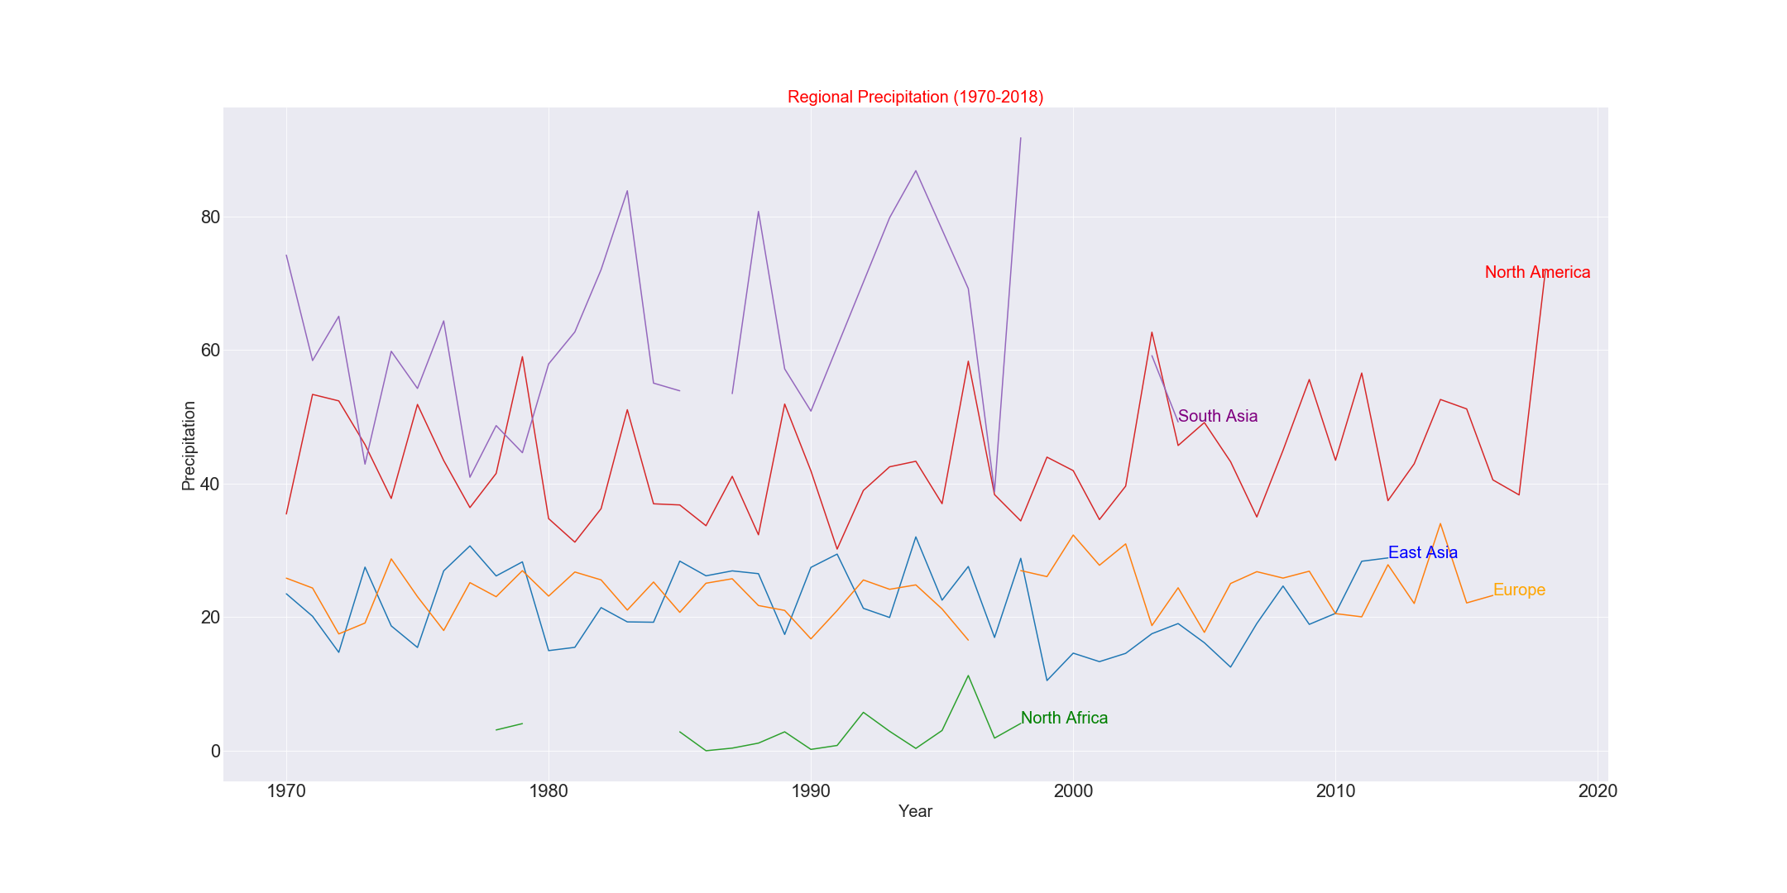
Precipitation
Overview
Climate Trends
Pollution Trends
Natural Disasters
Final Takeaways

Slide 10

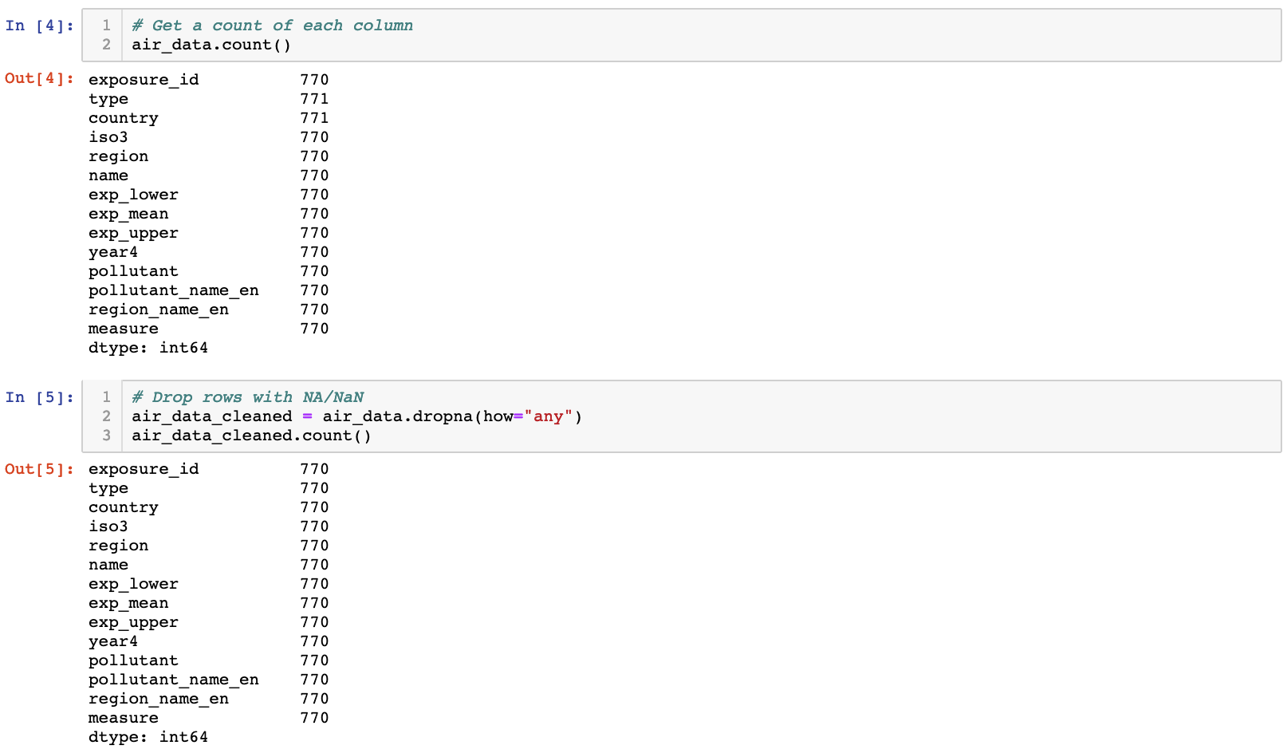
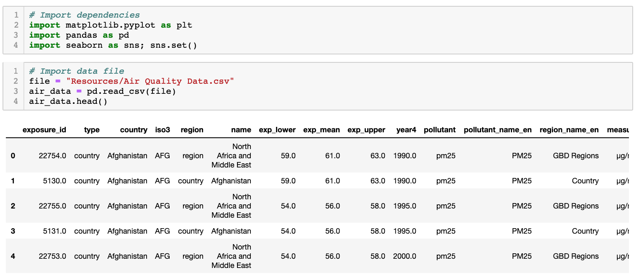
Air Quality: Data Exploration
Import dependencies
Import dataset
View dataset
View counts in each column
Drop rows with empty values
Overview
Climate Trends
Pollution Trends
Pollution Trends
Natural Disasters
Final Takeaways

Slide 11

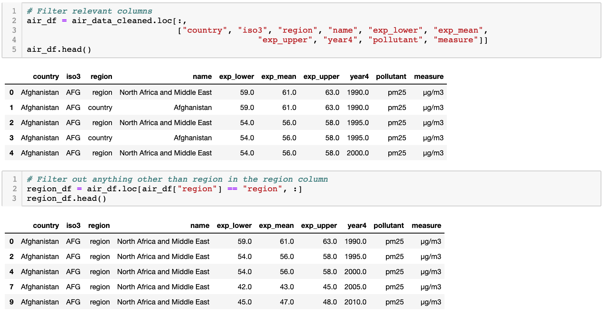
Air Quality: Data Cleaning
Create a new dataframe with relevant columns
Filter “regions” column to remove unnecessary rows (duplicates)
Overview
Climate Trends
Climate Trends
Pollution Trends
Pollution Trends
Natural Disasters
Final Takeaways

Slide 12
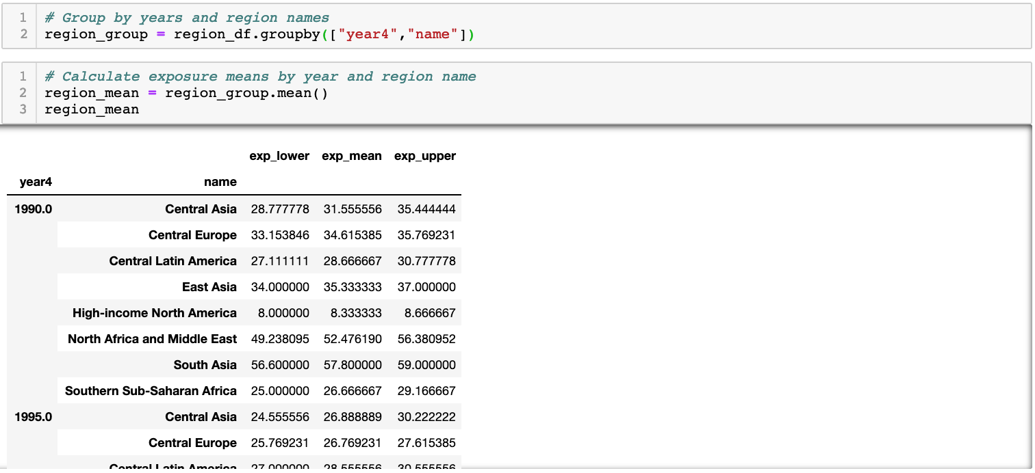
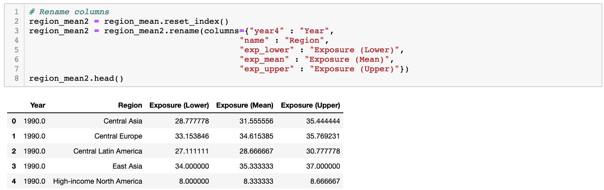
Air Quality: Data Cleaning
Group by the year and the region in order to find the mean
Reset index to plot and rename columns
Overview
Climate Trends
Climate Trends
Pollution Trends
Pollution Trends
Natural Disasters
Final Takeaways

Slide 13
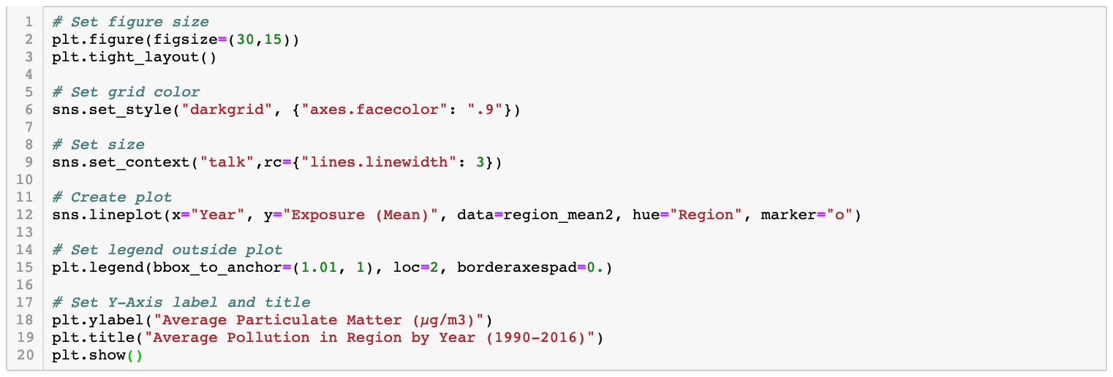
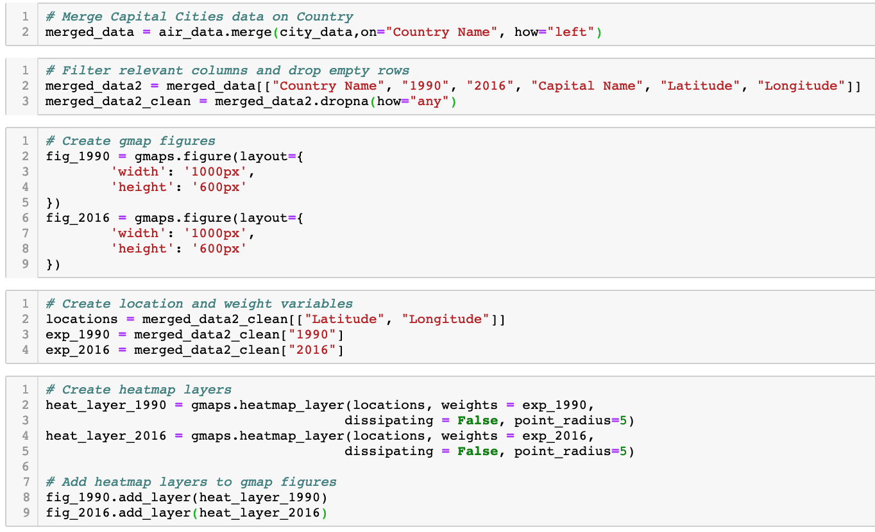
Air Quality: Visualization
Overview
Climate Trends
Climate Trends
Pollution Trends
Pollution Trends
Natural Disasters
Final Takeaways

Slide 14
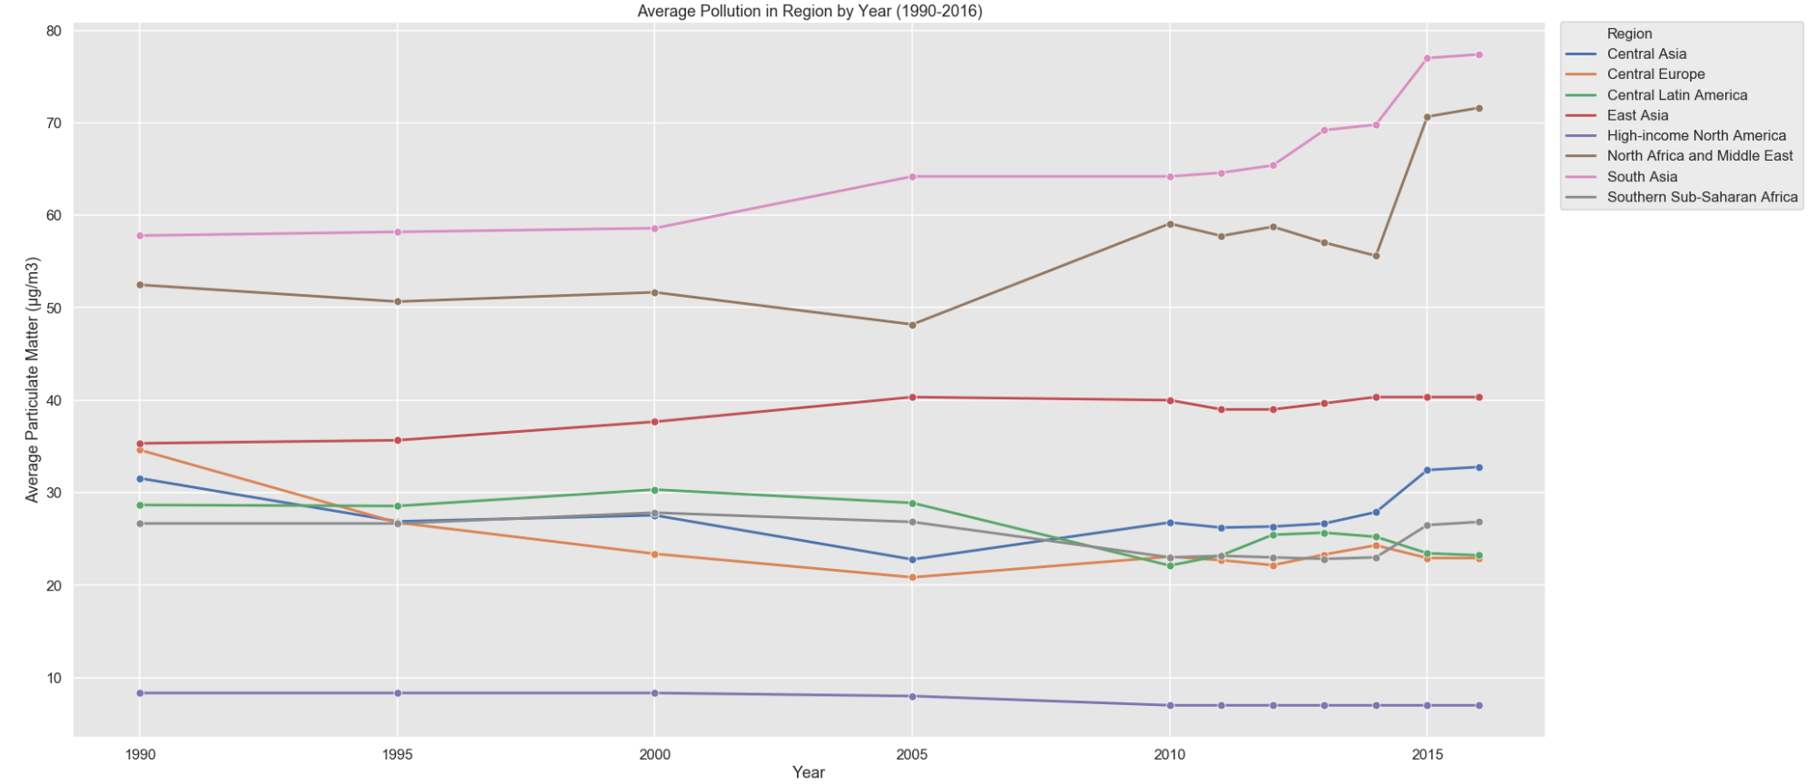
Air Quality: Global Pollution at a Glance
Observations:
Changes occur relatively slow
Significant changes starting 2014
Regions that start high trend high, regions that start low trend low
Overview
Climate Trends
Climate Trends
Pollution Trends
Pollution Trends
Natural Disasters
Final Takeaways

Slide 15
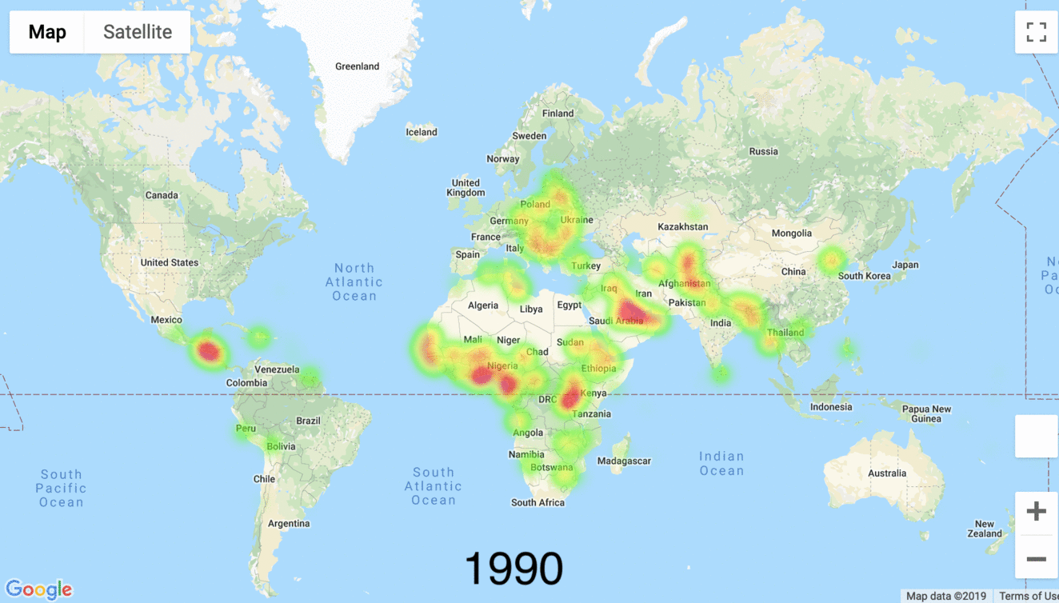
Air Quality: How Has Pollution Changed?
Observations:
North African, Middle East, and South Asian countries seem to show the strongest increase in pollutant exposure
Central Asian countries show minor increases
European countries seem to drastically decrease in pollutant exposure
Latin American countries show minor decreases
North American countries show relatively the lowest amounts of pollutant exposure
Overview
Climate Trends
Climate Trends
Pollution Trends
Pollution Trends
Natural Disasters
Final Takeaways

Slide 16
Global Natural Disasters: Hurricane, Earthquake
Quick Facts:
What is the difference between a hurricane, a cyclone, and a typhoon?
They are all the same; the only difference is the location where the storm occurs.
Hurricane - Atlantic and NE Pacific
Typhoon - NW Pacific Ocean
Cyclones - S Pacific and Indian Ocean
Hurricane Category | Wind Speed
Five | ≥ 157 mph
Four | 130–156 mph
Three | 111–129 mph
Two | 96–110 mph
One | 74–95 mph
Overview
Climate Trends
Climate Trends
Pollution Trends
Pollution Trends
Natural Disasters
Final Takeaways

Slide 17
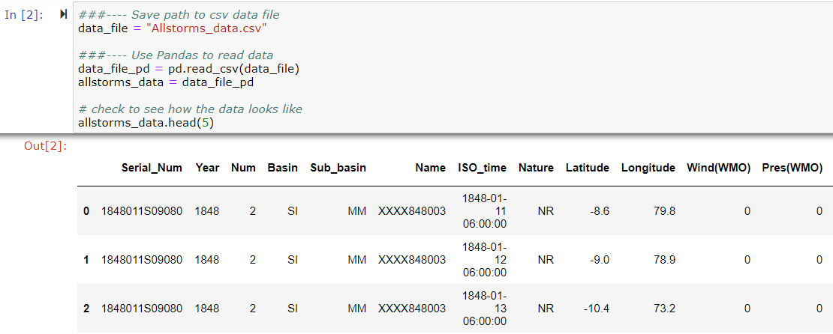
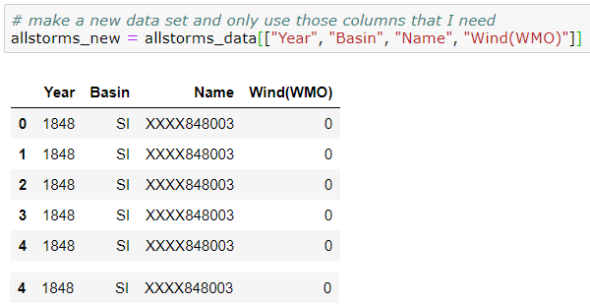
Global Natural Disasters: Hurricane, Earthquake
Download and cleaning data
Overview
Climate Trends
Climate Trends
Pollution Trends
Pollution Trends
Natural Disasters
Final Takeaways

Slide 18
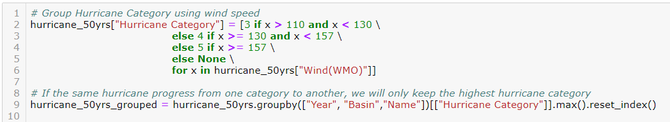
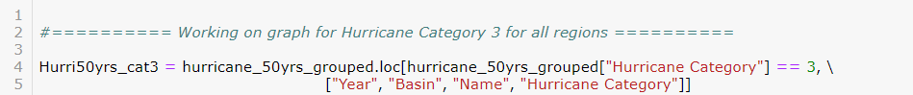
Download and cleaning data
Overview
Climate Trends
Climate Trends
Pollution Trends
Pollution Trends
Natural Disasters
Final Takeaways

Slide 19
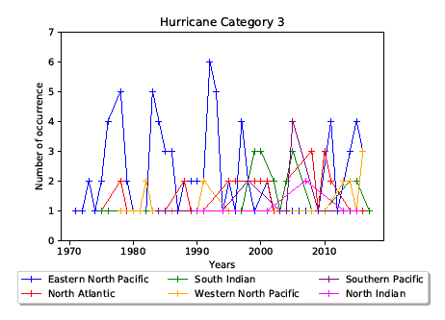
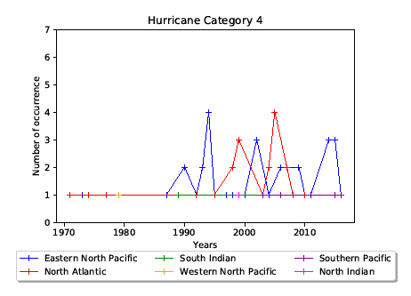
Global Natural Disasters: Hurricane (1970-2016)
Overview
Climate Trends
Climate Trends
Pollution Trends
Pollution Trends
Natural Disasters
Final Takeaways

Slide 20
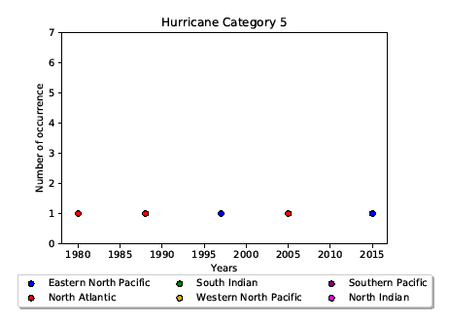
Global Natural Disasters: Hurricane (1970-2016)
Hurricane category 3 and 4 start to happen more often since the 1990s and the trend is still going
Hurricane category 5 only happens once every 7-10 year for the past 50 years
Overview
Climate Trends
Climate Trends
Pollution Trends
Pollution Trends
Natural Disasters
Final Takeaways

Slide 21
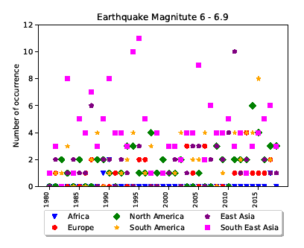
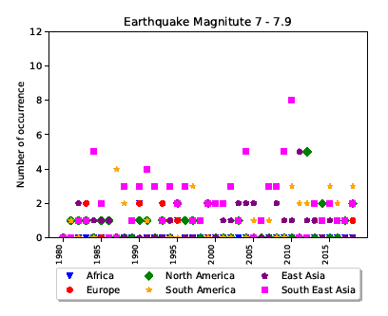
Global Natural Disasters: Earthquake (1980-2018)
Overview
Climate Trends
Climate Trends
Pollution Trends
Pollution Trends
Natural Disasters
Final Takeaways

Slide 22
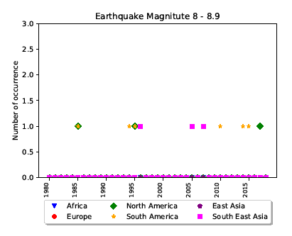
Global Natural Disasters: Earthquake (1980-2018)
From 1980s to 2000, earthquake mag 6-6.9 happened more often in Asia but since 2000 start to happen around the world
On the flip side, earthquake mag 7-7.9 used to happen around the world during 1980s and 1990s but since then it seems to only concentrate in Asia
For the past 10 years, earthquake mag 8 and high seems to happen in South America the most
Overview
Climate Trends
Climate Trends
Pollution Trends
Pollution Trends
Natural Disasters
Final Takeaways

Slide 23
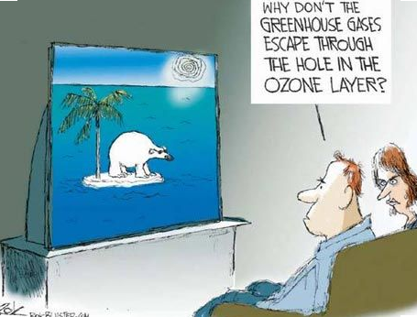
Over the last 30 years:
Pollution
Deteriorating In Developing Regions
Improving in Developed Regions
Temperatures Are Getting Higher Across the Board. Precipitation fluctuates significantly.
Natural Disasters… Yes… But Not yet
Time Is Running Out
Overview
Climate Trends
Pollution Trends
Natural Disasters
Final Takeaways

